Slide 1
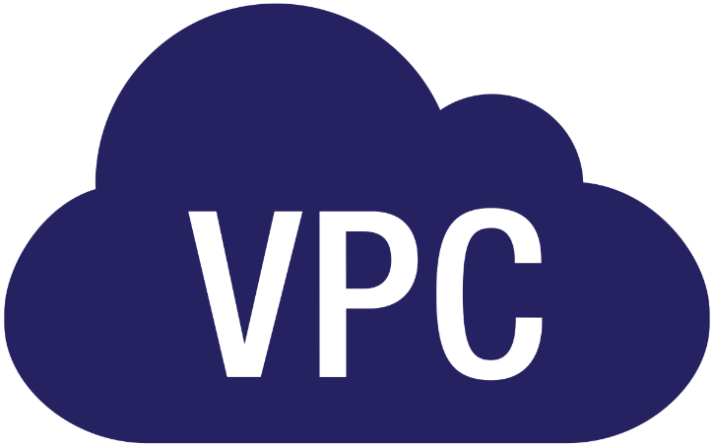

Slide 2

Topics
What is VPC
VPC Features
Default VPC vs Custom VPC
VPC Peering
Nat Instances
Nat Gateway
NACL
VPC Flow Logs
A Bastion Host
Direct Connect

Slide 3
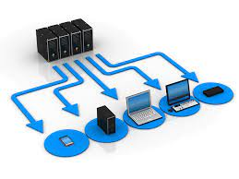
What is a VPC?
Think of VPC as virtual data center in cloud.
Amazon's Virtual Private Cloud (Amazon VPC) lets you provision a logically isolated section of the Amazon
Web Services cloud where you can launch AWS resources in a virtual network that you define.
You have complete control over your virtual networking environment including selection of your own IP address ranges, creation of subnets and configuration of route tables as well as network gateways.

Slide 4
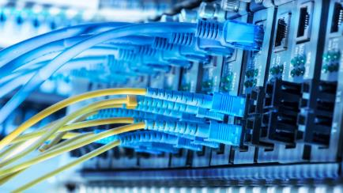
What is a VPC?
You can easily customize the network configuration for your Amazon virtual private cloud.
For example, you can create a public-facing subnet for your web servers that has access to the Internet and place your backend systems such as databases or application servers in a private-facing subnet with no internet access.
So, in doing that your web servers are exposed to the Internet, but your sensitive application and database servers are not exposed to the Internet.

Slide 5
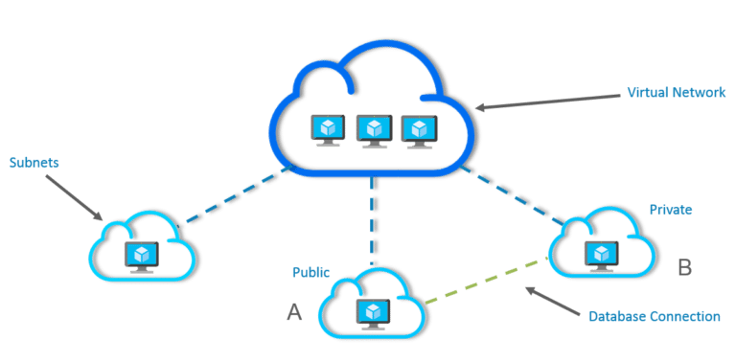
What is a VPC?
You can leverage multiple layers of security including security groups as well as network access control list to help you control access to Amazon EC2 instances in each subnet
Additionally, you can create hardware Virtual Private Network (VPN) connection between your corporate data center and your VPC and leverage the AWS cloud as an extension of your corporate data center.

Slide 6
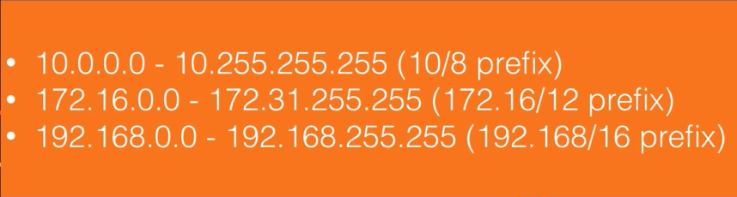
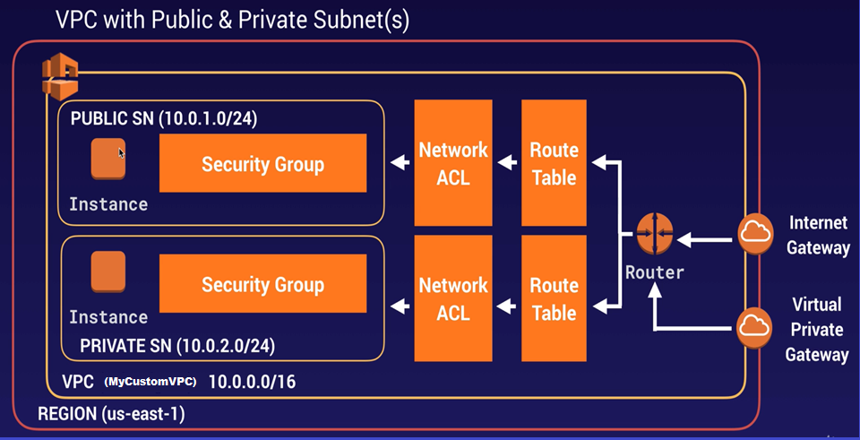
VPC

Slide 7
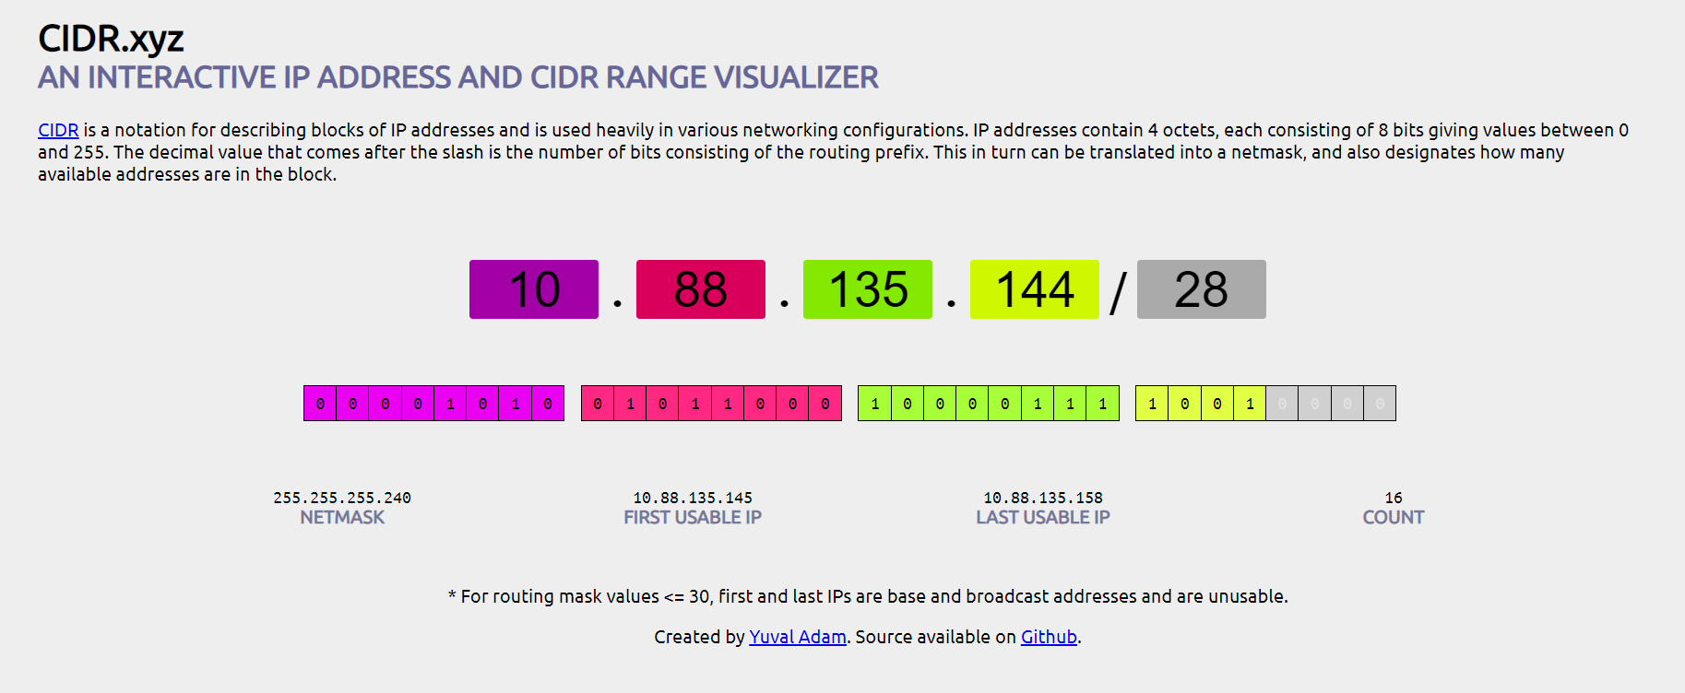
CIDR

Slide 8
VPC Features
Launch instances into a subnet of our choosing.
Assign custom IP address ranges in each subnet
Configure route tables between subnets
Create Internet gateways and attach it to our VPC
Much better security controls over our AWS resources
Assign security groups to individual instances
Subnet network access control lists (Nacl)

Slide 9
Default VPC vs Custom VPC
Default VPC is user friendly, allows you to immediately deploy instances.
You don't need to know anything about networking to be able to provision and deploy to instance in the AWS as console.
All subnets in a default VPC have a route out to the Internet. That means they all have Internet accessible
Each Ec2 instance has a both a public and private IP address.
If you do delete a default VPC you can recover it now

Slide 10
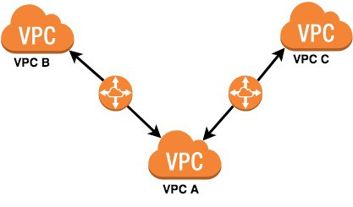
VPC Peering
Allows you to connect one VPC with another via down direct network route using private IP addresses
Instances behave as if they were on the same private network
You can peer VPC's with other AWS accounts as well as with other VPC is in the same account
Peering is in a star configuration: one central VPC peers with 4 others. NO TRANSITIVE peering.
You can peer between regions.

Slide 11
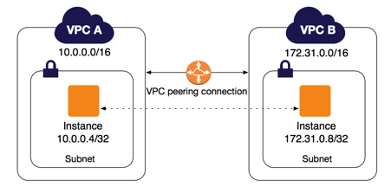
VPC Peering

Slide 12
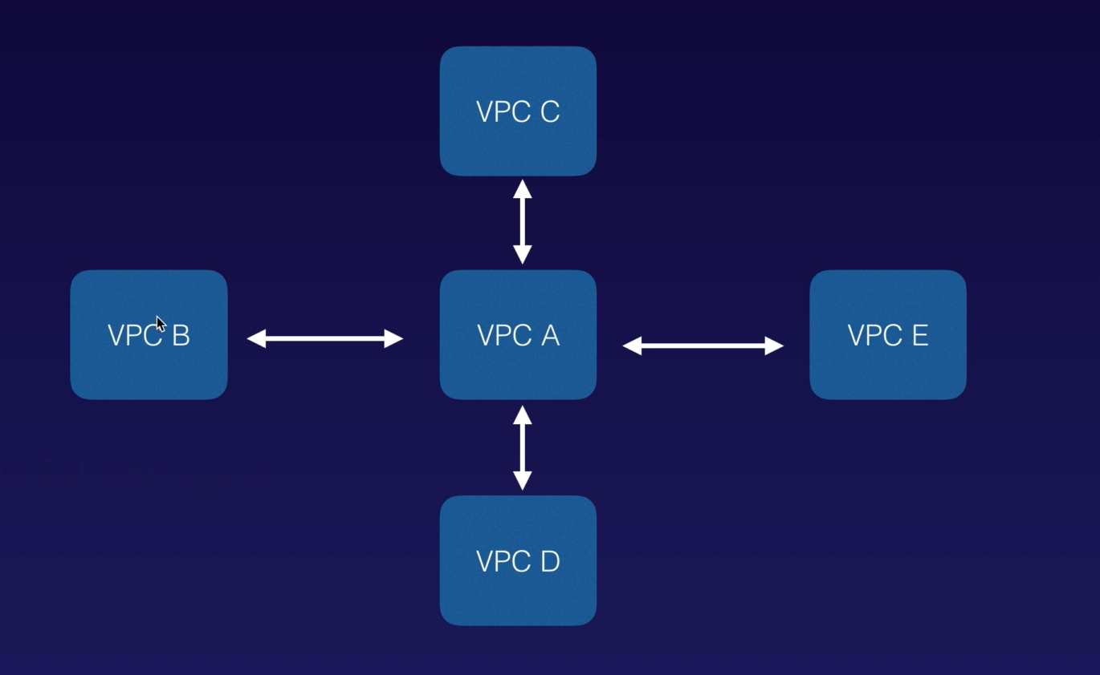
VPC Peering

Slide 13
NAT Instances
When creating a NAT instance, Disable Source/Destination Check on the instance.
NAT instances must be in a public subnet
There must be a route out of the private subnet to the NAT instance for this to work.
The amount of traffic that NAT instances can support depends on the instance size. If you are bottlenecking, increase the instance size.
You can create high availability using Autoscaling Group, multiple subnets in different AZs and a script to automate failover.
Behind Security Group

Slide 14
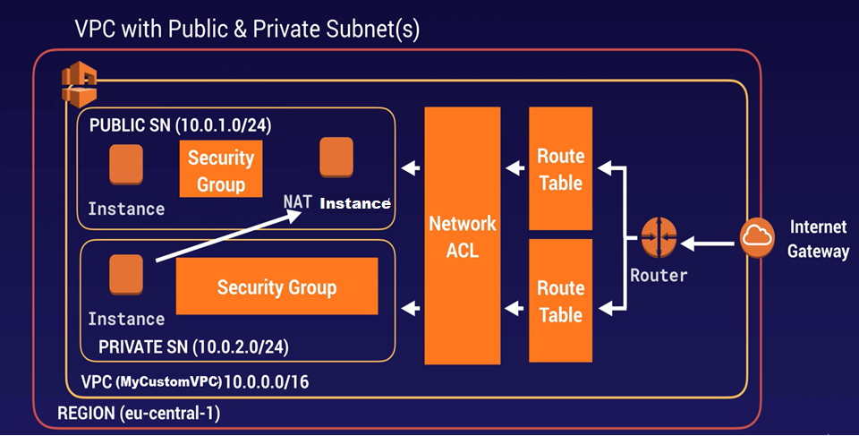
NAT Instance

Slide 15
NAT Gateway
Redundant inside the Availability Zone
Preferred by the enterprise
Starts at 5Gbps and scales currently to 45Gbps
No need to patch
Not associated with security groups
Automatically assigned a public ip address
Remember to update your route tables
No Need to disable Source/Destination Checks

Slide 16
Nat Gateway
If you have resources in multiple Availability Zones and they share one NAT gateway, if the NAT gate’s Availability Zone is down, resources in the other Availability Zones lose internet access.
To create an availability Zone-independent architecture, create a NAT gateway in each Availability Zone and configure your routing to ensure that resources use the NAT gateway in the same Availability Zone.

Slide 17

NAT Gateway

Slide 18
NACL
Your VPC automatically comes with a default network ACL and by default it allows all outbound and inbound traffic.
You can create custom network ACLs. By default, each custom network ACL denies all inbound and outbound traffic until you add rules.
Each subnet in your VPC must be associated with network ACL. if you don't explicitly associate a subnet with a network ACL, the subnet is automatically associated with the default network ACL
Block IP addresses using network ACLs not Security Groups.

Slide 19
NACL
You can associate a network ACL with multiple subnets; however, a subnet can be associate with only one network ACL at a time.
When you associate a network ACL with a subnet, the previous association is removed
Network ACLs contain a numbered list of rules that is evaluated in order, starting with the lowest numbered rule.
Network ACLs have separated inbound and outbound rules and each rule can either allow or deny traffic
Network ACLs are stateless; responses to allowed inbound traffic are subject to the rules for outbound traffic (and vice versa)

Slide 20
VPC Flow Logs
VPC Flow Logs is a feature that enables you to capture information about the IP traffic going to and from network interfaces in your VPC.
Flow log data is stored using Amazon CloudWatch Logs. After you've created a flow log, you can view and retrieve its data in Amazon CloudWatch Logs
Create at 3 level:
VPC
Subnet
Network Interface Level
You cannot enable flow logs for VPCs that are peered with your VPC unless the peer VPC is in your account

Slide 21
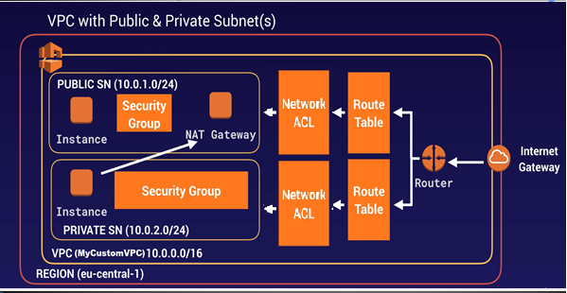
NACL

Slide 22
VPC Flow Logs
You can tag flow logs
After you've created a flow log, you cannot change its configuration; for example, you can't associate a different IAM role with the flow log.
Not all IP Traffic is monitored;
Traffic generated by instances when they contact the Amazon DNS server. If you use your own DNS server, then all traffic to that DNS server is logged
Traffic generated by a Windows instance for Amazon Windows license activation
Traffic to and from 169.254.169.254 for instance metadata
DHCP traffic
Traffic to the reserved IP address for the default VPC router

Slide 23
A Bastion Host
A bastion host is a special purpose computer on a network specifically designed and configurated to withstand attacks.
The computer generally hosts a single application, for example a proxy server and all other service are removed or limited to its location and purpose, which is either on the outside of a firewall or in a demilitarized zone (DMZ) and usually involves access from untrusted networks or computers
A NAT Gateway or NAT Instance is used to provide internet traffic to EC2 instances in a private subnets
A Bastion is used to securely administer EC2 instances(Using SSH or RDP). Bastions are called Jump Boxes in Australia
You cannot use a NAT Gateway as a Bastion Host

Slide 24
Direct Connect
AWS Direct Connect is a cloud service solution that makes it easy to establish a dedicated network connection from your premises to AWS.
Using AWS Direct Connect, you can establish private connectivity between AWS and your datacenter, office or colocation environment, which in many cases can reduce your network costs, increase bandwidth throughput and provide a more consistent network experience than Internet-based connections
Direct Connect directly connects your data center to AWS
Useful for high throughput workloads (i.e., lots of network traffic) Or if you need a stable and reliable secure connection
https://www.youtube.com/watch?v=dhpTTT6V1So

Slide 25
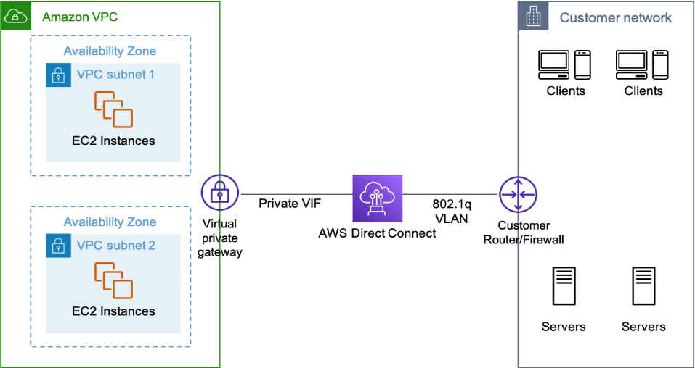
Direct Connect

Slide 26


Direct Connect
Direct Connect Location
AWS Backbone Network
Cust. / Provider Link
Customer
Router
Dx
Router
Public
Dx Connector
X-connect
Pseudo-wire/ LAN Extension
Customer WAN/MAN Router
AWS Cage
Customer / Partner Cage
Dx
Router
Customer
Router
Private
Cust. / Provider Link
AWS Backbone Network
AWS Region
Customer
WAN/MAN/LAN

Slide 27
VPC Endpoint
A VPC endpoint enables you to privately connect your VPC to supported AWS services and VPC endpoint services powered by private link without requiring an Internet gateway, a NAT device, a VPN connection or an AWS direct connect connection.
Instances in your VPC do not require public IP addresses to communicate with the resources in the service.
Traffic between your VPC and other services does not leave the Amazon network.
Endpoints are virtual devices. They are horizontally scaled, redundant and highly available VPC components that allow communication between instances in your VPC and services without imposing availability, risk or bandwidth constraints on your network traffic.

Slide 28
VPC Endpoint
Two types of VPC endpoints.
Interface endpoints.
Gateway endpoints.
Gateways Endpoint
S3
Dynamo DB

Slide 29
VPC Endpoint
Interface endpoints.
Interface endpoints is an elastic network interface (EMI) with a private IP address that serves as an entry point for traffic destined to a supported service.
The following services are supported:
API Gateway
CloudFormation
CloudWatch
CloudWatch Events
CloudWatch Logs
AWS CodeBuild
AWS Config
AWS Secrets Manager
AWS Security Token Services
AWS SNS
AWS SQS
EC2 API
ELB API
AWS KMS
AWS Kinesis Data Stream
AWS SageMaker
AWS SageMaker Runtime
AWS SageMaker Notebook Instance

Slide 30
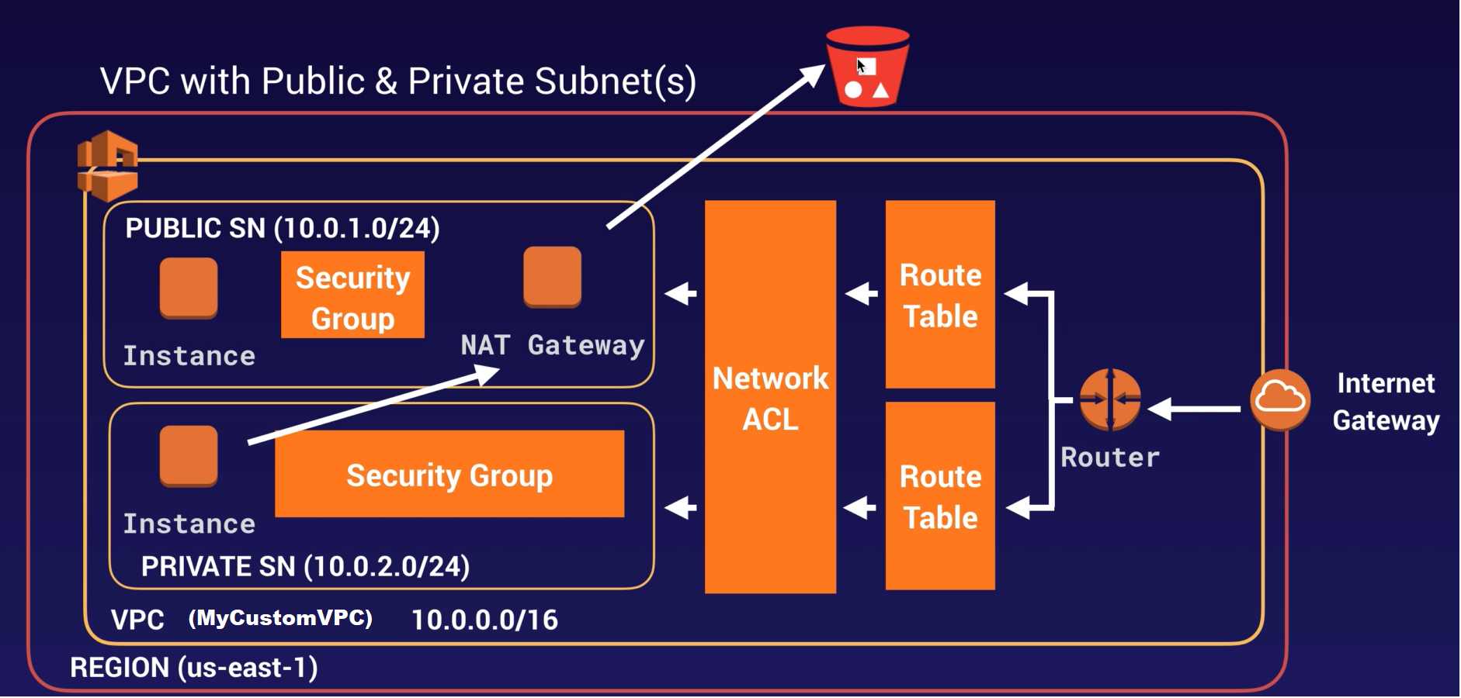
VPC Endpoint

Slide 31
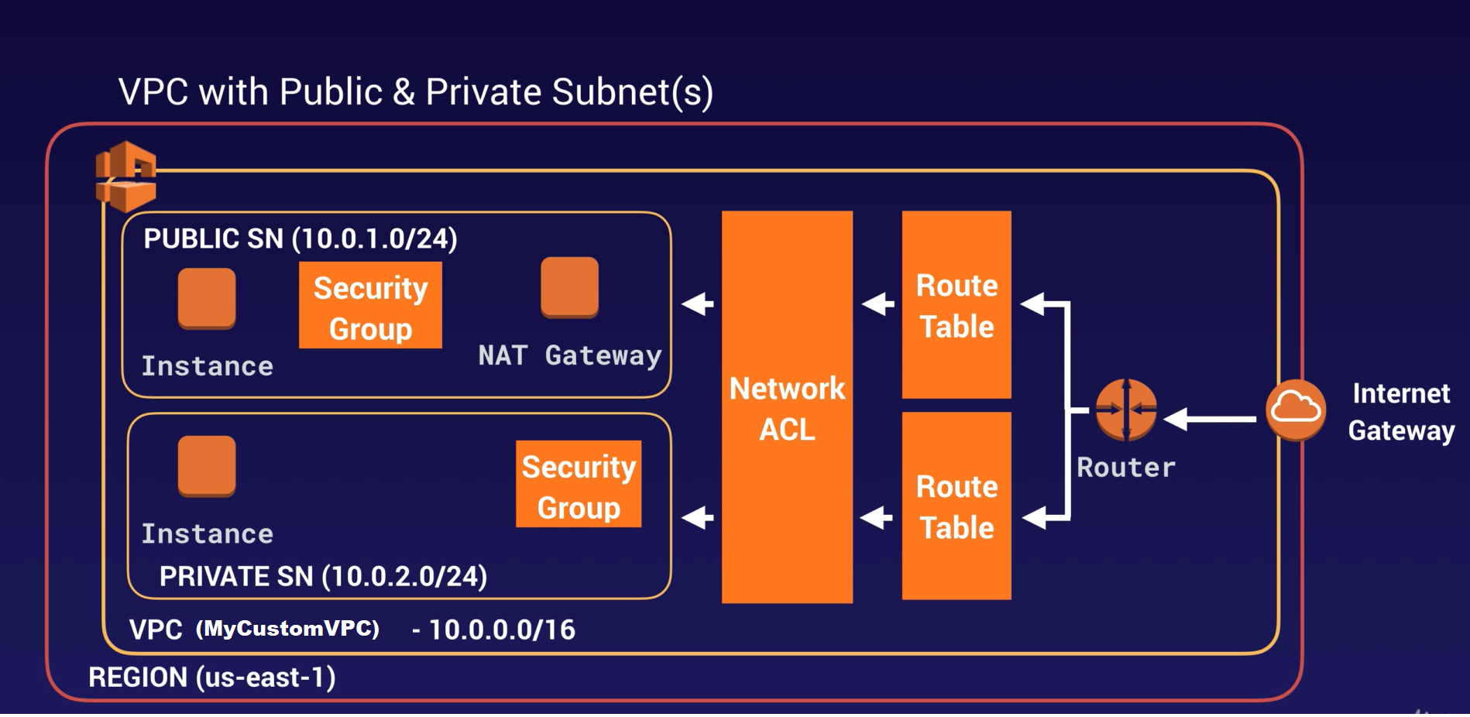


VPC Endpoint
VPC Endpoint

Slide 32
Exam Tips - VPC
Think of a VPC as logical datacenter in AWS
Consists of IGWs(or Virtual Private Gateway), Route Tables, Network Access Control Lists, Subnet and Security Groups
1Subnet = 1 Availability Zone
Security Groups are Stateful, Network Access Control are Stateless
NO TRANSITIVE PEERING

Slide 33
Exam Tips - VPC
When You Create a VPC a default Route table, Network Access Control List(NACL) and a default Security Group.
It won't create any subnets, nor will it create a default internet gateway
US-EAST-1A in your AWS account an be a completely different availability zone to US-EAST-1A in another AWS account. The AZs are randomized.
Amazon Always reserve 5 IP addresses within your subnets
You can only have 1 Internet Gateway per VPC
Security Group can't span VPCs

Slide 34
Exam Tips - NAT Instance
When Creating a NAT instance, Disable Source/Destination Check on the Instance.
NAT instance must be in a public subnet
There must be a route out of the private subnet to the NAT instance, for this to work
The amount of traffic that NAT instances can support depends on the instance size. If you are bottlenecking, increase the instance size.
You can create high availability using Autoscaling Groups, multiple subnets in different AZs and a script to automate failover
Behind a security Group

Slide 35
Exam Tips - NAT Gateway
Redundant inside the Availability Zone
Preferred by the enterprise.
Starts at 5Gbps and scales currently to 45Gbps
No need to patch
Not associated with security groups
Automatically assigned a public IP addresses
Remember to update your route tables
No need to disable Source/Destination Checks

Slide 36
Exam Tips - NAT Gateway
If you have resources in multiple Availability Zones and they share one NAT Gateway, if the NAT gateway’s Availability Zone is down, resources in the other Availability Zones lose internet access.
To create an Availability Zone-independent architecture, create a NAT Gateway in each Availability Zone and configure your routing to ensure that resources use the NAT gateway in the same Availability Zone

Slide 37
Exam Tips - NACL
Your VPC automatically comes with a default network ACL and by default it allows all inbound and outbound traffic.
You can create custom network ACLs. By default, each custom network ACL denies all inbound and outbound traffic until you add rules
Each subnet in your VPC must be associated with a network ACL.
If you don't explicitly associate a subnet with a network ACL, the subnet is automatically associated with the default network ACL

Slide 38
Exam Tips - NACL
Block IP addresses using network ACLs not Security Groups
You can associate a network ACL with multiple subnets; however, a subnet can be associated with only one network ACL at a time.
When you associate a network ACL with a subnet, the previous association is removed
Network ACLs contain a numbered list of rules that is evaluated in order, starting with the lowest numbered rules
Network ACLs have separate inbound and outbound rules and each rules can either allow or deny traffic.
Network ACLs are stateless; responses to allowed inbound traffic are subject to the rules for outbound traffic(and vice-versa)

Slide 39
Exam Tips - Flow Logs
You cannot enable flow logs for VPCs that are peered with your VPC unless the peer VPC is in your account
You can tag flow logs
After you've created a flow log, you cannot change its configuration; for example, you can't associate a different IAM role with the flow log
Not all IP traffic is monitored;
Traffic generated by instances when they contact the Amazon DNs server.
If you use your own DNS server, then all traffic to that DNS server is logged
Traffic generated by a Windows instance for Amazon Windows license activation
Traffic to and from 168.254.169.254 for instance metadata
DHCP traffic

Slide 40
Exam Tips- Bastion Host
A NAT Gateway or NAT Instance is used to provide internet traffic to EC2 instances in a private subnets.
A Bastion is used to securely administer EC2 instances (Using SSH or RDP).
Bastion are called Jump Boxes in Australia.
You cannot use a NAT Gateway as a Bastion host

Slide 41
Exam Tips - Direct Connect
Direct Connect directly connects your data center to AWS
Useful for high throughout workload( i.e., lots of network traffic)
If you need a stable and reliable secure connection

Slide 42
Exam Tips - VPC Endpoint
A VPC endpoint enables you to privately connect your VPC to supported AWS services and VPC endpoint services powered by private link without requiring an Internet gateway, a NAT device, a VPN connection or an AWS direct connect connection.
Instances in your VPC do not require public IP addresses to communicate with the resources in the service.
Traffic between your VPC and other services does not leave the Amazon network.
Endpoints are virtual devices. They are horizontally scaled, redundant and highly available VPC components that allow communication between instances in your VPC and services without imposing availability, risk or bandwidth constraints on your network traffic.

Slide 43
Exam Tips - Extra
VPC – Private Link (VPC-to-VPC using Amazon private link for connecting more then 10VPC)
VPC – Transit Gateway (Allow you to have transitive peering between thousand of VPCs and on-premises data centers)
VPN – Hub (If you have multiple sites, each with its own VPN connection, you can use AWS VPN Cloud Hub to connect those sites together)
VPC Global Accelerator (Use AWS edge location to accelerate the performance)

Slide 44
Thank you

